Slide 1
Chapter IV
Data Converter and Connectors

Slide 2
Analog to Digital and Digital to Analog Conversion
The most naturally occurring phenomena are analog in nature. Analog quantities are continuous functions of time and most transducers give an analog output.
Digital to analog converters are used in computer driven CRT displays, digital generation of analog waveforms, and digital control of automatic process control systems.
Moreover, some popular A/D conversion techniques use D/A converters for functioning.

Slide 3

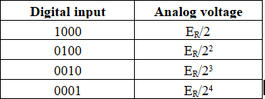


General Considerations of Analog to Digital and Digital to Analog Conversion

Slide 4




Slide 5
Digital to Analog Converter (DAC)
Following are the types of DAC:
Weighted Resistor Network (WRN) DAC
R:2R Ladder Network DAC

Slide 6
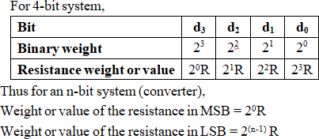
Weighted Resistor Network DAC
In WRN DAC, the resistor is weighted reverse of the binary system i.e., resistance associated with MSB has the least value and as we move from MSB to LSB, the resistance value increases with a factor 2 as given in the following table.
7

Slide 7
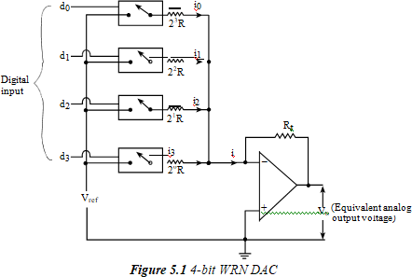
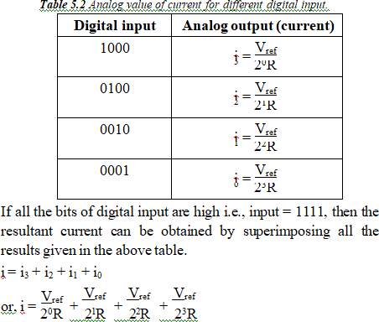
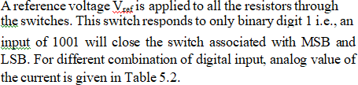

Slide 8
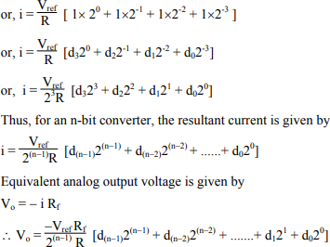

Slide 9
Drawbacks of the WRN network DAC:
1. As the no. of bit increases, the resistance value also increases. Thus, for higher bit converter, the range of resistor becomes very high and it becomes difficult to fabricate all the resistors in the same IC.
2. For higher bit converter, the tolerance value of resistance in LSB becomes much greater than actual value in the MSB.

Slide 10
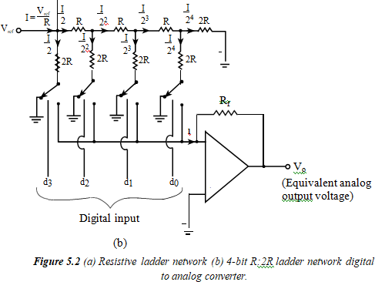
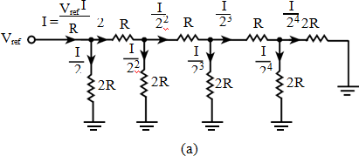
R:2R Ladder Network DAC
The two drawbacks of weighted resistor network can be overcome using R:2R ladder network, as in this DAC, only two value resistors are used.

Slide 11

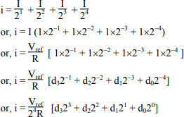
Right hand side of each node of Figure 5.2 (a) has two equal resistors each having resistance 2R connected in parallel. So, the current reaching to any node will be divided into two equal parts. The current will be divided according to the expression
Thus, the resistive ladder network of Figure 5.2 (a) generates a binary sequence of the current. If all the bits of digital inputs of Figure 5.2 (b) are high i.e., input equals 1111, then the resultant current is given by

Slide 12
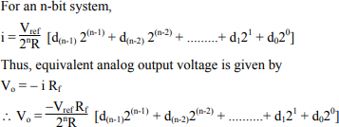

Slide 13
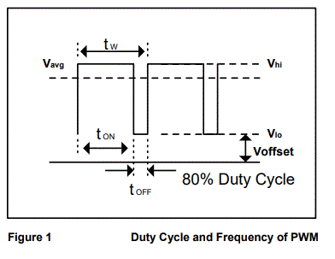
PWM type DAC Pulse Width Modulation (PWM) refers to a form of signal modulation where data is represented by the ratio of the on time to the total time (known as the duty cycle). PWM has the property where the instantaneous DC component is directly proportional to the duty cycle. It is primarily used for controlling digital encoded analog signal of varying amplitude. Vavg 80% Duty Cycle t ON t OFF Vhi Vlo t W Voffset Figure 1 Duty Cycle and Frequency of PWM The relationship between the time-average voltage (Vavg) the high and low voltages of the square wave (Vhi and Vlo) and the duty cycle (D) in percent is as follows: Vavg = (Vhi - Vlo) * D + Voffset ……………….……………………….……………….…..…[1] where D = tON / tW or D = PWDR value/1023 (for 10-bit PWM) ……………………………[2] If Vhi is 5V, Vlo is 0V (i.e. Voffset = 0) and D is 80%, Vavg would be 4 V. Another important parameter of PWM is the frequency. It is defined by number of pulse per second. f = 1 / tW………………………………………………………………….….….….….….…..[3] where tW = tON + tOFF………………………………………………………………….….…...[4] From equations [2] and [3], it can be proven that F = D / tON…………………………………………………………………….…...…...….......[4]

Slide 14
Quantization Error
In-order to convert an analog quantity to a digital number involves quantization. The characteristics of a Quantizer are shown in Fig. 26.104.
This quantizer is used for conversion of analog voltages of 0-7 V. Now in binary code, decimal number 7 = binary 111.
Therefore the digital number has 3 bits.
The analog input is shown in Fig. 26.104 (a) on the horizontal axis and the discrete output voltage level on the vertical axis.
The basic operation of A/D conversion involves two processes, (i) quantization and (ii) coding
The decision levels of the A/D convertor are at 0.5, 1.5, 2.5. 3.5, etc. Thus the design levels are spaced 1 V apart. Analog values between two decision levels cannot be coded. In fact, analog values between 1 ±0.5 are read as digital value 001.
The distance between decision levels is Q, the quantization size. An n bit A/D converter has 2^n discrete levels with resolution = 1/2" or 1 part in 2" and analog decision levels = 2"-l.

Slide 15
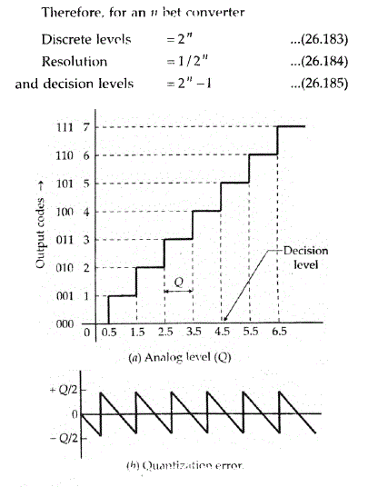

Slide 16
If the input to the quantizer is moved through its full range and subtracted from the discrete output levels, the error signal is shown in Fig. 26.104(h).
This is called quantization error.
The quantization error is dependent on the number of quantization levels.
The quantization levels are an index of the resolution of the instrument.
The quantization error is of a sawtooth waveform as shown in Fig. 26.104(b).
The peak to peak value is Q. The output of a quantizer can be considered as a noise signal with an rms value of
Eq =Q/2√3 ..(26.186)
which is the quantization error.

Slide 17
Analog to Digital Converter (ADC)
Analog to digital converters are of following types:
Successive Approximation (SA) ADC
Ramp ADC
Dual Ramp ADC (Dual Slope ADC)
Flash ADC (or Parallel ADC)
Countertype ADC
Introduction to Delta-Sigma ADC

Slide 18
Successive Approximation (SA) Type ADC:
Successive approximation ADC is probably the most commonly used analog-to-digital converter.
This method is based on comparing the input analog voltage with another analog voltage
until the two are equal or as close as it is possible to set them.
Figure 5.3 illustrates the subsystems involved.

Slide 19
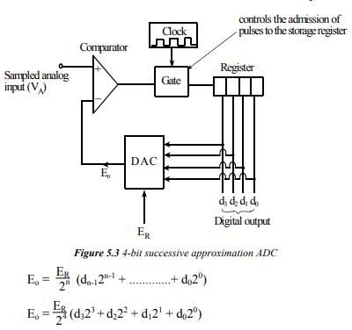
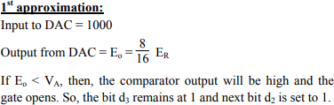
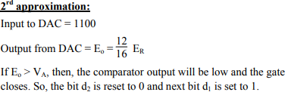
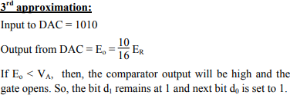

Slide 20
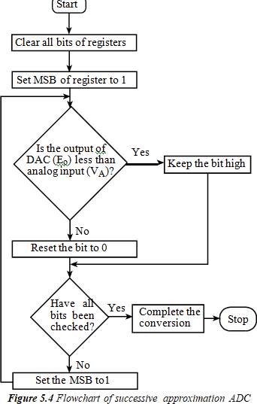
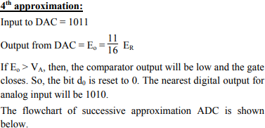

Slide 21
Successive approximation principle can be easily understood using a simple example; the determination of the weight of an object.
By using a balance and placing the object on one side and an approximate weight on the other side, the weight of the object is determined.
If the weight placed is more than the unknown weight, the weight is removed and another weight of smaller value is placed and again the measurement is performed.
Now if it is found that the weight placed is less than that of the object, another weight of smaller value is added to the weight already present, and the measurement is performed.
If it is found to be greater than the unknown weight, the added weight is removed and another weight of smaller value is
added.
In this manner by adding and removing the appropriate weight, the weight of the unknown object is determined.

Slide 22
Ramp ADC
The ramp form of analog-to-digital converter involves an analog voltage which is increased at a constant rate, a so-called ramp voltage.
This ramp voltage is generated by a capacitor being charged from a constant current source.
The time taken for the ramp voltage to increase to the value of the input analog voltage will depend on the size of the sampled analog voltage.
Figure 5.5 indicates the subsystems involved in the ramp form of analog-to- digital converter. Ramp ADCs are cheap but relatively slow.

Slide 23
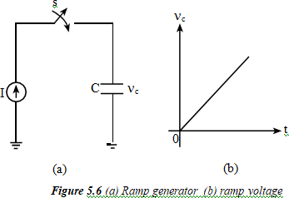
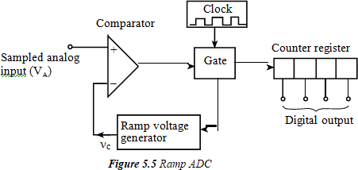
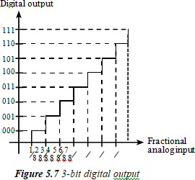
Ramp ADC
1 2 3 4 5 6 7 8
8 8 8 8 8 8 8 8

Slide 24
Ramp ADC
The ramp form of analog-to-digital converter involves an analog voltage which is increased at a constant rate, a so-called ramp voltage.
This ramp voltage is generated by a capacitor being charged from a constant current source.
The charge q on the capacitor is It, where I is the constant current and t the time for which the current charges the capacitor.
Since the potential difference across the capacitor is q/C ,
then the potential difference is proportional to the time for which the charging occurs and so a ramp voltage is produced.
The ramp voltage is applied to a comparator where it is compared with the input analog voltage.
The time taken for the ramp voltage to increase to the value of the input analog voltage will depend on the size of the sampled analog voltage.
When the ramp voltage starts, a gate is opened which starts a binary counter counting the regular pulses from a clock.
When the two voltages are equal, the gate closes and the word indicated by the counter is the
digital representation of the sampled analog voltage.
Figure 5.5 indicates the subsystems involved in the ramp form of analog-to-digital converter.
Ramp ADCs are cheap but relatively slow

Slide 25
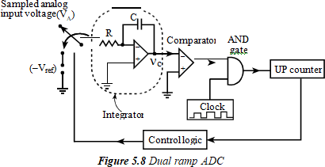
Dual Ramp ADC (Dual Slope ADC)
The accuracy of the single ramp ADC can be improved by using the dual ramp ADC.

Slide 26
Dual Ramp ADC (Dual Slope ADC)
Figure 5.8 shows the different components of dual ramp ADC. It consists of an
integrator which produces a ramp signal ( Vc) from constant sampled analog input (Va).
Then, there is a comparator to drive the AND gate whose another input is clock pulse of certain frequency.
The gate drives an up counter which on certain condition sends the signal to control logic to switch the input from Va to -Vref.
When Va is a applied to the integrator, it produces a ramp signal whose slope is equal to -Va/RC .
Then, the gate opens. So, the up counter will count upto its full scale (111 for 3 bit) and then resets.
As it resets, it sends the signal to the control logic to switch the input to reference voltage ( -Vref).
Now, the voltage Vc will increase with the slope Vref/RC.
When this negative voltage reaches zero, the gate will be closed and up
counter pauses. The digital code seen in the counter will be the equivalent output to the input analog voltage (Va).

Slide 27
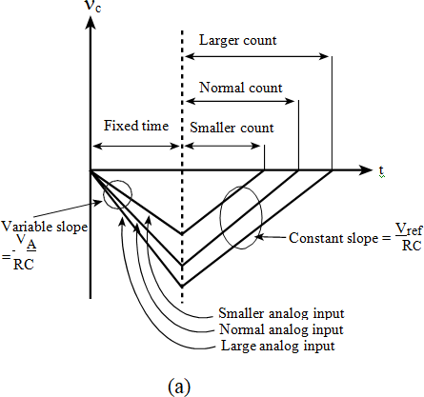
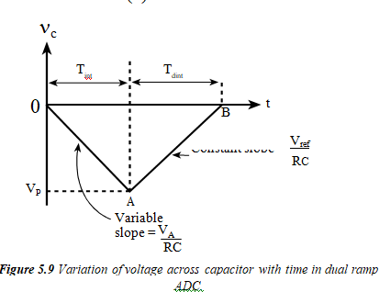
Dual Ramp ADC (Dual Slope ADC)

Slide 28

Figure 5.8 shows the different components of dual ramp ADC.
It consists of an integrator which produces a ramp signal (n_{c}) from constant sampled analog input (V_{A}).
Then, there is a comparator to drive the AND gate whose another input is clock pulse of certain frequency.
The gate drives an up counter which on certain condition sends the signal to control logic to switch the input from V_{A} to -V_{ref}. When V_{A} is a applied to the integrator, it produces a ramp signal whose slope is equal to
Then, the gate opens.

Slide 29
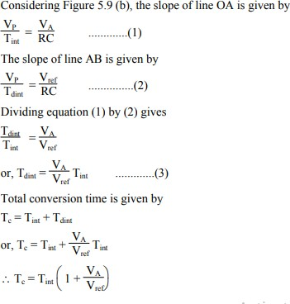
Considering Figure 5.9 (b), the slope of line OA is given by

Slide 30
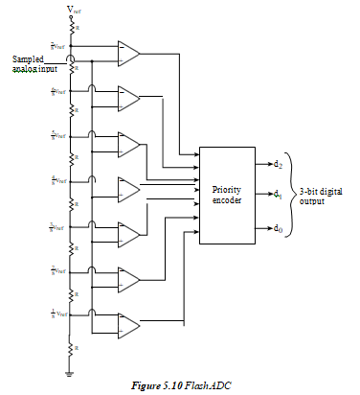
Flash ADC (Parallel ADC)
27

Slide 31
Flash ADC (Parallel ADC)
The flash analog-to-digital converter is a very fast, but more costly form of ADC. For an n-bit converter, separate voltage comparators are used in parallel as shown in Figure 5.10.
Each comparator has sampled analog voltage (VA) as one of its inputs.
A reference voltage is applied to a ladder of resistors so that the reference voltage applied to each comparator is one bit higher in size than the reference voltage applied to the lower previous comparator.
When the sampled analog input voltage is applied, all those comparators for which analog voltage is greater than reference voltage, element will go high and those for which analog voltage is less than the reference voltage, element will go low. The resulting outputs of the comparators are applied in parallel to the encoder which translates them into the digital output.
Since all the bits of the output digital word are simultaneously produced, this converter is very fast.
2n 1

Slide 32
Flash ADC (Parallel ADC)
The flash analog-to-digital converter is a very fast, but more costly form of ADC.
For an n-bit converter, 2^{n} -1 separate voltage comparators are used in parallel as shown in Figure 5.10.

Slide 33
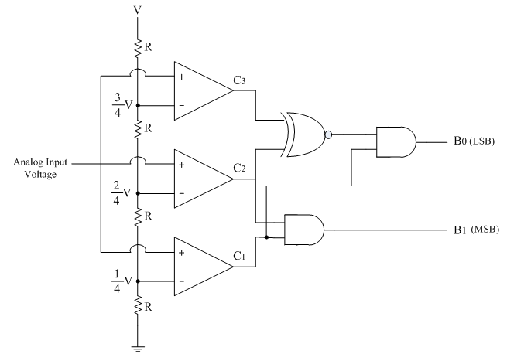
Flash Type ADC
Flash Type ADC is based on the principle of comparing analog input voltage with a set of reference voltages.
To convert the analog input voltage into a digital signal of n-bit output, (2^{n} – 1) comparators are required.
The following figure shows 2- bit flash type ADC

Slide 34
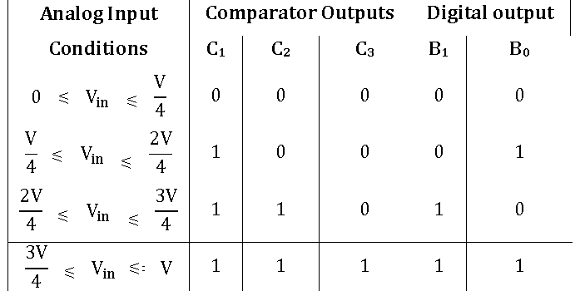
The three op-amps are used as comparators. The non-inverting inputs of all the three comparators are connected to the analog input voltage. The inverting terminals are connected to a set of reference voltages (V/4), (2V/4) and (3V/4) respectively which are obtained using a resistive divider network and power supply +V.
The output of the comparator is in positive saturation(i.e. logic 1), when voltage at non-inverting terminal is greater than voltage at inverting terminal and is in negative saturation otherwise.
The following table shows the comparator outputs for different ranges of analog input voltages and their corresponding digital outputs.

Slide 35
Consider first condition, where analog input voltage VA is less than (V/4). In this case, the voltage at the non-inverting terminals of all the three comparators is less than the respective voltages at inverting terminals and hence the comparator outputs are C1C2C3 = 000.
This comparator outputs are applied to the further coding circuit to get the digital outputs as B1B0 = 00
Similarly the digital outputs are calculated for other three conditions also.
Advantages:
1)It is the fastest type of ADC because the conversion is performed simultaneously through a set of comparators, hence referred as flash type ADC. Typical conversion time is 100ns or less.
2)The construction is simple and easier to design.
Disadvantages:
1)It is not suitable for higher number of bits.
2)To convert the analog input voltage into a digital signal of n-bit output, (2^{n} – 1) comparators are required. The number of comparators required doubles for each added bit.

Slide 36
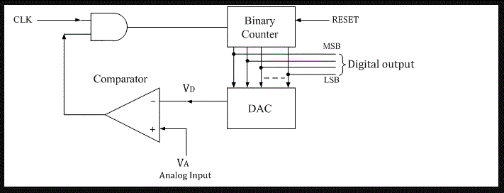
Counter type ADC
The counter type ADC is constructed using a binary counter, DAC and a comparator.
The output voltage of a DAC is VD which is equivalent to corresponding digital input to DAC.
The following figure shows the n-bit counter type ADC.

Slide 37
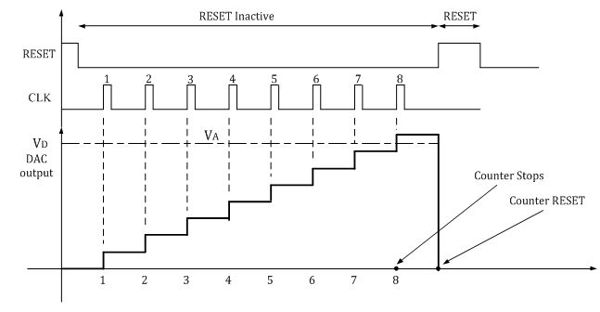

Slide 38
Operation:
The n-bit binary counter is initially set to 0 by using reset command. Therefore the digital output is zero and the equivalent voltage VD is also 0V.
When the reset command is removed, the clock pulses are allowed to go through AND gate and are counted by the binary counter.
The D to A converter (DAC) converts the digital output to an analog voltage and applied as the inverting input to the comparator.
The output of the comparator enables the AND gate to pass the clock.
The number of clock pulses increases with time and the analog input voltage VD is a rising staircase waveform as shown in figure below.
The counting will continue until the DAC output VD, equals and just rises more than unknown analog input voltage VA. Then the comparator output becomes low and this disables the AND gate from passing the clock.
The counting stops at the instance VA< VD, and at that instant the counter stops its progress and the conversion is said to be complete.

Slide 39
The numbers stored in the n-bit counter is the equivalent n-bit digital data for the given analog input voltage.
Advantages:
1 Simple construction.
2 Easy to design and less expensive.
3 Speed can be adjusted by adjusting the clock frequency.
4 Faster than dual slope type ADC.

Slide 40
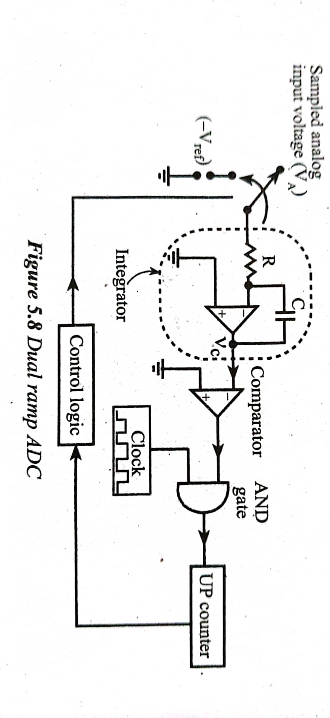
Dual Slope type ADC
In dual slope type ADC, the integrator generates two different ramps, one with the known analog input voltage VA and another with a known reference voltage –Vref.
Hence it is called a s dual slope A to D converter.
The logic diagram for the same is shown below.

Slide 41
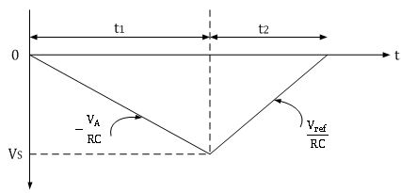
Operation:
The binary counter is initially reset to 0000; the output of integrator reset to 0V and the input to the ramp generator or integrator is switched to the unknown analog input voltage VA.
The analog input voltage VA is integrated by the inverting integrator and generates a negative ramp output. The output of comparator is positive and the clock is passed through the AND gate. This results in counting up of the binary counter.
The negative ramp continues for a fixed time period t1, which is determined by a count detector for the time period t1. At the end of the fixed time period t1, the ramp output of integrator is given by
∴VS=-VA/RC×t1
The dual ramp output waveform is shown below.

Slide 42
When the counter reaches the fixed count at time period t1, the binary counter resets to 0000 and switches the integrator input to a negative reference voltage –Vref.
Now the ramp generator starts with the initial value –Vs and increases in positive direction until it reaches 0V and the counter gets advanced.
When Vs reaches 0V, comparator output becomes negative (i.e. logic 0) and the AND gate is deactivated.
Hence no further clock is applied through AND gate.
Now, the conversion cycle is said to be completed and the positive ramp voltage is given by
∴VS=Vref/RC×t2
Where Vref & RC are constants and time period t2 is variable.
Since ramp generator voltage starts at 0V, decreasing down to –Vs and then increasing up to 0V, the amplitude of negative and positive ramp voltages can be equated as follows.
∴Vref/RC×t2=-VA/RC×t1
∴t2=-t1×VA/Vref
∴VA=-Vref×t1/t2
Thus the unknown analog input voltage VA is proportional to the time period t2, because Vref is a known reference voltage and t1 is the predetermined time period.

Slide 43
The actual conversion of analog voltage VA into a digital count occurs during time t2.
The binary counter gives corresponding digital value for time period t2.
The clock is connected to the counter at the beginning of t2 and is disconnected at the end of t2.
Thus the counter counts digital output as
Digital output=(counts/sec) t2
∴Digital output=(counts/sec)[t1×VA/Vref ]
For example, consider the clock frequency is 1 MHz, the reference voltage is -1V, the fixed time period t1 is 1ms and the RC time constant is also 1 ms. Assuming the unknown analog input voltage amplitude as VA = 5V, during the fixed time period t1 , the integrator output Vs is
∴VS=-VA/RC×t1=(-5)/1ms×1ms=-5V
During the time period t2, ramp generator will integrate all the way back to 0V.
∴t2=VS/Vref ×RC=(-5)/(-1)×1ms=5ms=5000μs
Hence the 4-bit counter value is 5000, and by activating the decimal point of MSD seven segment displays, the display can directly read as 5V.

Slide 44
Delta-Sigma ADC
One of the more advanced ADC technologies is the so-called delta-sigma, or ΔΣ (using the proper Greek letter notation). In mathematics and physics, the capital Greek letter delta (Δ) represents difference or change, while the capital letter sigma (Σ) represents summation: the adding of multiple terms together. Sometimes this converter is referred to by the same Greek letters in reverse order: sigma-delta, or ΣΔ.
In a ΔΣ converter, the analog input voltage signal is connected to the input of an integrator, producing a voltage rate-of-change, or slope, at the output corresponding to input magnitude. This ramping voltage is then compared against ground potential (0 volts) by a comparator.
The comparator acts as a sort of 1-bit ADC, producing 1 bit of output (“high” or “low”) depending on whether the integrator output is positive or negative. The comparator’s output is then latched through a D-type flip-flop clocked at a high frequency, and fed back to another input channel on the integrator, to drive the integrator in the direction of a 0 volt output. The basic circuit looks like this:

Slide 45
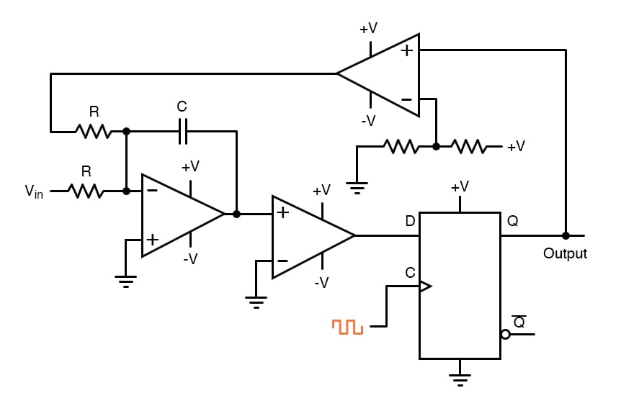
Schematic Diagram
The leftmost op-amp is the (summing) integrator. The next op-amp the integrator feeds into is the comparator, or 1-bit ADC. Next comes the D-type flip-flop, which latches the comparator’s output at every clock pulse, sending either a “high” or “low” signal to the next comparator at the top of the circuit.
This final comparator is necessary to convert the single-polarity 0V / 5V logic level output voltage of the flip-flop into a +V / -V voltage signal to be fed back to the integrator. If the integrator output is positive, the first comparator will output a “high” signal to the D input of the flip-flop.

Slide 46
At the next clock pulse, this “high” signal will be output from the Q line into the noninverting input of the last comparator. This last comparator, seeing an input voltage greater than the threshold voltage of 1/2 +V, saturates in a positive direction, sending a full +V signal to the other input of the integrator.
This +V feedback signal tends to drive the integrator output in a negative direction. If that output voltage ever becomes negative, the feedback loop will send a corrective signal (-V) back around to the top input of the integrator to drive it in a positive direction.
This is the delta-sigma concept in action: the first comparator senses a difference (Δ) between the integrator output and zero volts. The integrator sums (Σ) the comparator’s output with the analog input signal.
Functionally, this results in a serial stream of bits output by the flip-flop. If the analog input is zero volts, the integrator will have no tendency to ramp either positive or negative, except in response to the feedback voltage.
In this scenario, the flip-flop output will continually oscillate between “high” and “low,” as the feedback system “hunts” back and forth, trying to maintain the integrator output at zero volts:

Slide 47
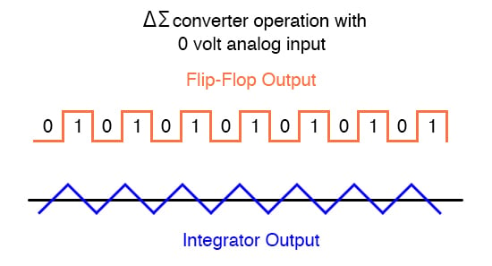
Output Waveforms

Slide 48
Parameters for selection of ADC/DAC
Resolution
  Resolution of an ADC is smallest change that can be distinguished in the analog input.
Resolution = FSR (Full Scale Range) / 2^{n}
Conversion Time
  The total time required converting an analog signal into its digital output.
Accuracy
  It is the comparison of the actual output and the expected output.
Linearity
  The output should be the linear function of input.
Full scale output value
  The maximum bit output achieved from the respective input.
Error Specification
Power Consumption
Size
Cost
Interface Requirement

Slide 49
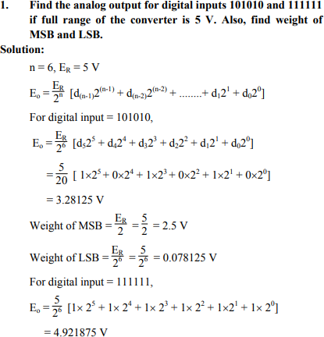

Slide 50
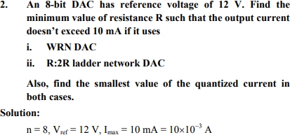
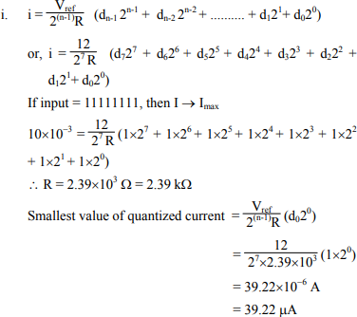

Slide 51
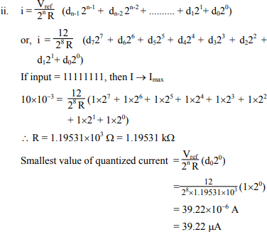

Slide 52
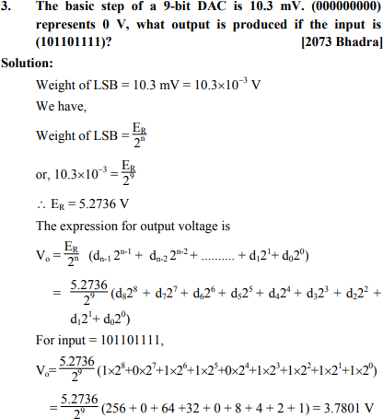

Slide 53
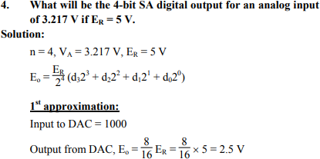
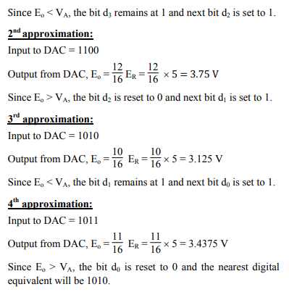

Slide 54
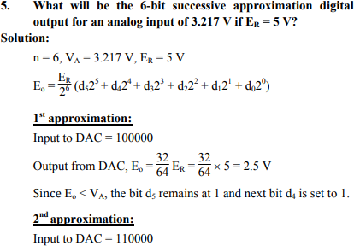

Slide 55
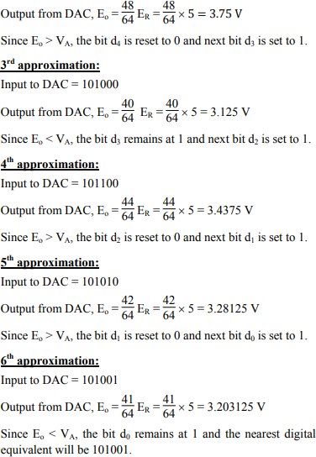

Slide 56
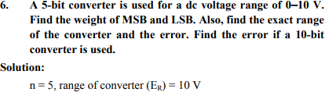

Slide 57
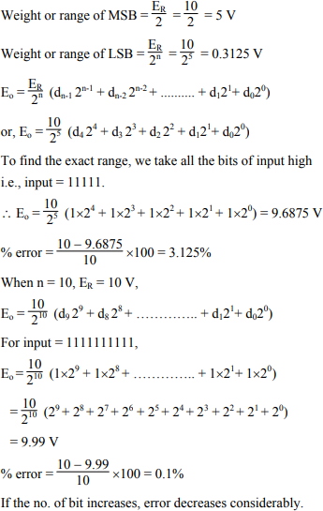

Slide 58
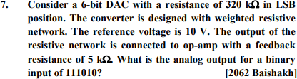
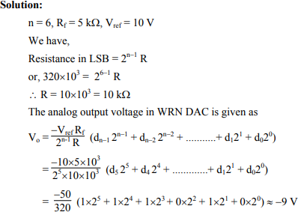

Slide 59
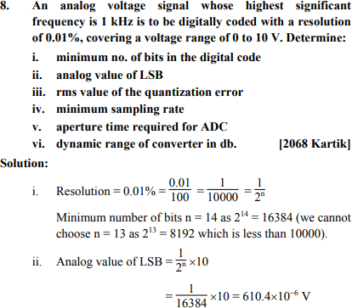

Slide 60
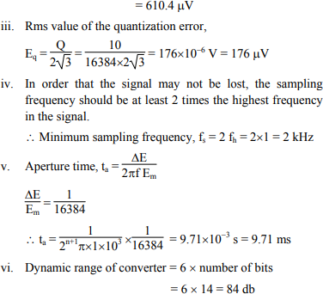

Slide 61
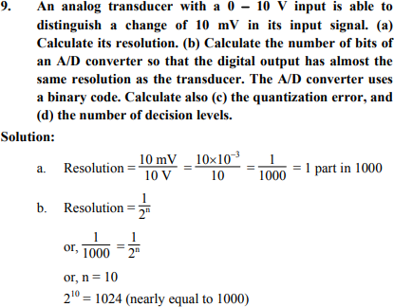


Slide 62
Counter-Type ADC
The counter-type Analog-to-Digital Converter (ADC) is also known as the digital ramp ADC. It is because the output of the counter is fed to a Digital-to-Analog Converter (DAC), and while the counter increments its count, the output of the DAC increases in ramp fashion or staircase fashion.
The counter-type ADC uses a counter for conversion from analog to digital.
Counter-Type ADC Operation
During the start of the conversion, the output of DAC is zero.
So, whatever input voltage V_{in} is applied at the positive terminal of the comparator, the output of the comparator is high.
Since it is high, the AND gate is enabled and it allows the clock pulse to pass.
The counter then starts counting the clock pulses. The output of the counter is fed to the DAC, which computes the decimal equivalent of its binary input.
Now, the output of the DAC V_{DAC} increases in a staircase fashion and it is continuously compared with the input V_{in}. As long as V_{in} > V_{DAC}, the counter keeps counting.

Slide 63

Counter-type ADC

Slide 64
The moment V_{in} < V_{DAC}, the comparator output is low, and AND gate is disabled, therefore blocking the clock pulses.
Also, the control block notices this transition and puts a low signal in the clear pin of the counter, thereby resetting it.
Simultaneously, the last output of the counter is latched and this is the digital binary output of the given input voltage.
So, the basic principle of operation of the counter-type ADC is to keep counting the number of clock pulses till the input is greater than the DAC output and the moment DAC output is greater than the input, the counter is reset and the last count is latched and given as output.
Advantages
The counter-type ADC is simple and easy to use.
It is very accurate and the precision can be increased by increasing the number of bits.
While there are many complicated ADCs in the market, counter-type ADC has a fair balance of accurate output and cheap hardware costs.
Disadvantages
The major drawback of this ADC is that every time a new conversion starts, the counter is reset and it has to start counting right from all zeroes. Hence, the conversion time is significant.

Slide 65
High-voltage probes
A high voltage probe allows an ordinary voltmeter to measure voltages that would otherwise be too high to measure or even destructive. It does this by reducing the input voltage to a safe, measurable level with a precision voltage divider circuit within the probe body.
Probes intended for up to 100 kV typically employ a resistor voltage divider, with an input resistance of hundreds or thousands of megohms to minimize circuit loading.
High linearity and accuracy is achieved by using resistors with extremely low voltage coefficients, in matched sets that maintain a consistent, precise divider ratio across the probe's operating temperature.
Voltmeters have input resistance that effectively alters the probe's divider ratio, and parasitic capacitance that combines with the probe's resistance to form an RC circuit; these can easily reduce DC and AC accuracy, respectively, if left uncompensated.
To mitigate these effects, voltage divider probes usually include additional components that improve frequency response and allow them to be calibrated for different meter loads.

Slide 66


Slide 67

Probes and Connector
Current Probes
Many people use digital multimeters to measure properties such as current, voltage, and resistance. However, those instruments have a distinct disadvantage: to measure current with a digital multimeter, you have to shut off the electrical circuit so that the device can be connected in series.
This is where current probes come in handy. Since they don’t require an electrical connection to the circuit being measured, current probes provide an easy and convenient option for maintenance and troubleshooting work. This page provides a detailed introduction to current probes.

Slide 68

Instead of measuring current on their own like a digital multimeter, current probes are used in conjunction with an oscilloscope. They’re optional parts, but some can cost as much as the oscilloscope itself. The most noteworthy characteristic of current probes is their ability to measure AC and DC current in a non-contact manner, without requiring the electrical circuit to be shut off.
Digital multimeters, a common tool for measuring current, have to be connected in series with the circuit being measured, which means that the circuit has to be shut off while it’s measured. Current probes come in handy when you don’t want to do that.
Digital multimeters are convenient when you want to measure current and the electrical circuit is exposed, for example during the manufacturing process of an electronic device. However, there are many cases where it’s not possible to shut off a circuit so that it can be measured, for example when performing maintenance inspections of electronic equipment that is already operating or trying to pinpoint the location of a malfunction or failure.
In such situations, an instrument like a current probe that lets you measure current simply by clamping it around a wire can be extremely useful.

Slide 69

Low Capacitive Probes
Fig. 501. A 10-to-1 low-capacitance signal-tracing probe.

Slide 70
A Probe with very low input capacitance usually used in handling with high frequency signals as it doesn't present significant capacitive loading.
Low-capacitance probes are extremely useful for tracing wave forms in high-impedance, high-frequency and wide-band circuits (such as are found in TV receivers) without distortion from overloading or frequency discrimination.
It is important to note that scopes vary in input impedance. This statement applies, not only to scopes made by different manufacturers, but also to those of one manufacturer and even units of one model. The service technician, therefore, must ad just his probe to his particular scope. A variable resistor in the probe is used to obtain the desired attenuation of the input signal and a variable capacitor in the probe provides adjustable frequency compensation. This type of probe when used with a scope is particularly valuable for TV sync signal tracing and general tests in video, sync and sweep circuits.
A low-capacitance probe comprises a shielded resistor-capacitor network which increases the effective input impedance at the probe tip by a factor of 10 or more and, in so doing, attenuates the input signal to the probe by a similar amount. In certain TV servicing operations this necessary attenuation of the signal is a useful feature of the probe. In other applications, the attenuation is not required and is recovered by advancing the vertical gain control of the scope.
A low-capacitance probe must be constructed not only to have minimum stray capacitance to the probe shield, but must also be designed to attenuate voltages to protect suitably the scope input circuit whenever you test waveforms having high-amplitude peaks.

Slide 71


Network Cables:
The network cables are an essential part of signal connectivity solutions and they play a key role in ensuring connectivity in any office set up. When it comes to choosing patch network cables you have several choices based on their construction and designs. These cables are usually categorized into two classes – shielded cables and unshielded cables based on their construction.
Shielded Cables: This cable is also known as shielded twisted pair (STP) cable. It features individual wire pairs wrapped in a foil. These pairs are wrapped one more time to provide double protection. The shielding helps prevent EMI and other technical issues which may compromise the integrity of signals.
Unshielded Cables: This cable is usually referred to as unshielded twisted pair cable (UTP) where individual wire pairs are simply wrapped in a foil, without any additional layer of protection. Unshielded cables are ideal for office environments, which experience less traffic.

Slide 72
Shielded Cables:
Electromagnetic interference or EMI is one of the most common phenomena on the factory floor. EMI is a term used to define electrical noise that is usually conducted or radiated. This noise will not only affect the functioning of devices or equipment but also humans. Cable shielding helps prevent the effect of EMI on equipment and people. This means you will hear less crosstalk between cables. Also, additional insulation protects the cable from environmental elements and abuses that it may otherwise not withstand in an industrial environment. This means, if you are using shielded cables, there are fewer chances of it suffering from abrasion, scraps, spills, or moisture.
Unshielded Cables:
One of the main advantages of using an unshielded cable is that they do not need grounding. This helps save on installation time and costs.
Know About the Applications of Shielded Cables
Shielded cables are ideal for use in noisy environments where the chances and risks of EMI are high. Airports and radio stations are perfect examples of this type of environment. The following are a few more applications of these cables:
They are used in security systems to avoid radio frequency and power frequency interference. This helps reduce the number of false alarms, which may be otherwise disturbing.
Shielded twisted pair cables are also used in recording studios or public address systems. The twisted-pair cables help assure a balanced audio configuration.
The shielded cables are also used in box build applications, where different components are working close to each other.
Applications of Unshielded Cables
Shielded cables help minimize EMI. But, does that mean they are mandatory for every application? No, they are not mandatory for every application. Perhaps, you can also use unshielded cables for less noise applications such as home or office LANs. These cables are inexpensive, lightweight, as well as flexible.

Slide 73

Shielded Cable
Shielded cable is an electrical cable in which the conductor and its surrounding insulating layer have been encased in one or more conductive shields. These are usually made from metallic foil or braided wire. A protective jacket typically forms an outer layer. This works to minimize the electromagnetic interference (EMI) emitted and received by the cable. Power cables can be a major source of EMI in an environment. These can act as antennae in transmitting interference, or as receivers in acquiring and conducting interference to other devices. The level of EMI is a result of the power requirements of any electrical equipment in operation. A factory floor would typically have an ambient EMI level higher than that of an office or a residence. The degree of shielding necessary to mitigate interference will vary accordingly.

Slide 74

The two types of shielding most often used are metallic foil and braided wire. Foil shielding uses a thin layer of aluminum or copper backed by a polyester liner for strength. This technique supplies excellent coverage for the conductors, though foil is rather fragile. Attaching a connector and grounding can prove difficult. A drain wire, which is an uninsulated wire, is sometimes used to terminate and ground a foil shield.
A braided shield is a mesh woven from copper wire. This does not provide as effective coverage as foil. Copper's conductivity and the greater bulk of the wire mesh work together to make the braid an effective choice. It is also much easier to attach a connector and terminate to ground. This type of cable is more expensive than foil and increases the likelihood of size, weight, and flexibility issues.

Slide 75



Fig. Test Leads

Slide 76

Electrical Connectors and Wire Connectors
A connector is a coupling device that joins electrical terminations to create an electrical circuit. We design and manufacture an electrical connector types that are engineered to reliably transmit data, power, and signal in the harshest environments, under the most extreme use.
What are connectors?
Connectors enable contact between wires, cables, printed circuit boards, and electronic components. Our different types of connectors including PCB connectors and wire connectors are manufactured to reduce application size and power usage while enabling increased performance.

Slide 77
Thank You for your Attention
72

